Slide 1
BLOOD BANK SYSTEM
EFFORT BY :1.B K ANIRUDH(19BIT0348)
2.Lanka Jaswanth(19BIT0061)
3.B Manish Rao(19BIT0333)
4.Lakshmi Nivas(19BIT0189)
GUIDED BY : PROF. Jaykumar Sadhashivan

Slide 2
INTRODUCTION
The project BLOODBANK SYSTEM is a project that is designed for a blood bank to gather blood from various sources and distribute it to the needy people who have high requirements for it.
The software is designed to handle daily transactions of blood bank and search the details when required.
It also helps to register the details of donor, blood collection details as well as blood issued reports.
The software application is designed in such a manner that it can the needs of all blood bank requirements in the course of future.

Slide 3
ABSTRACT
The main aim to help needy people incase of emergencies.
Blood donor play very important role in the healthcare of patients in our community. Most population are eligible to donate blood yet very few actually do.
Every year, a huge number of individuals depend on accepting and giving blood to remain alive.
So, we have created a platform for blood donors where they can fill their details and our team will reach their locations for safe blood transfusion.
Blood bank may be one of the absolute best instances of unselfishness in real life for fulfilling the need of blood to people.

Slide 4
EXISTING SYSTEM
Time Consuming
Leads to error prone results
Consumes lot of manpower
Lack of donor details
Uncertainity of donor availability
Retrival of data takes more time
Accuracy is less

Slide 5
PROPOSED SYSTEM
Access from anywhere in the world
Access at anytime
Quick search
Better Communication
Time optimized
Cost optimized
Perfect for a volunteer

Slide 6
PROBLEM STATEMENT
Scarcity of rare blood groups.
Unavailability of blood during emergency.
Less awareness among people about blood donation and blood transfusion.
Deaths due to lack of blood during operations.
The Blood Bank System project aims to make all the procedures automated and therefore with computer system it can be more fast and accurate.
The project is software to manage all these cumbersome jobs.

Slide 7
DATA FLOW DIAGRAM

Slide 8
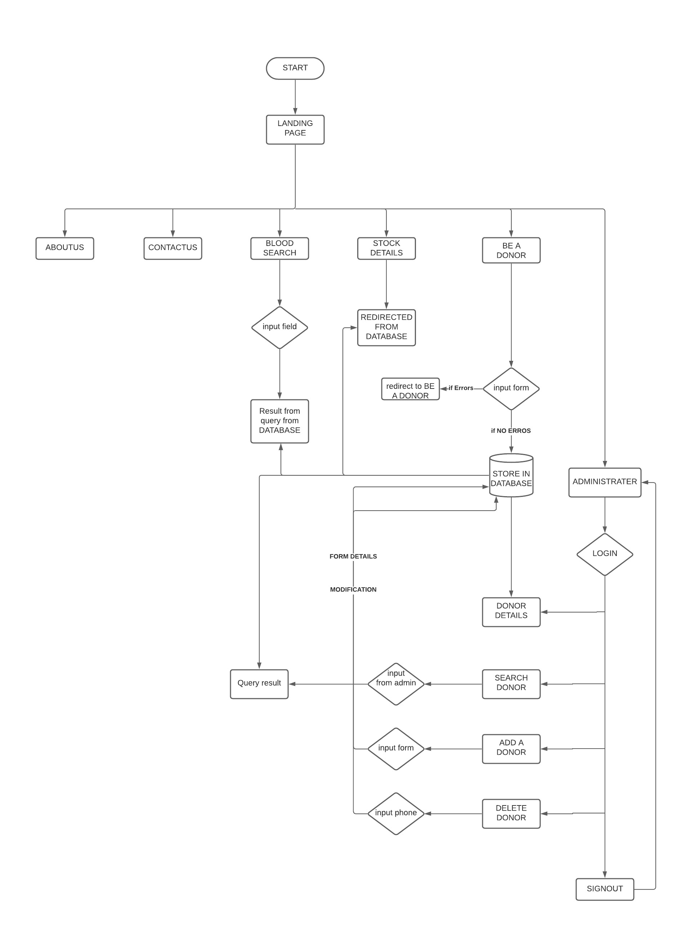

Slide 9
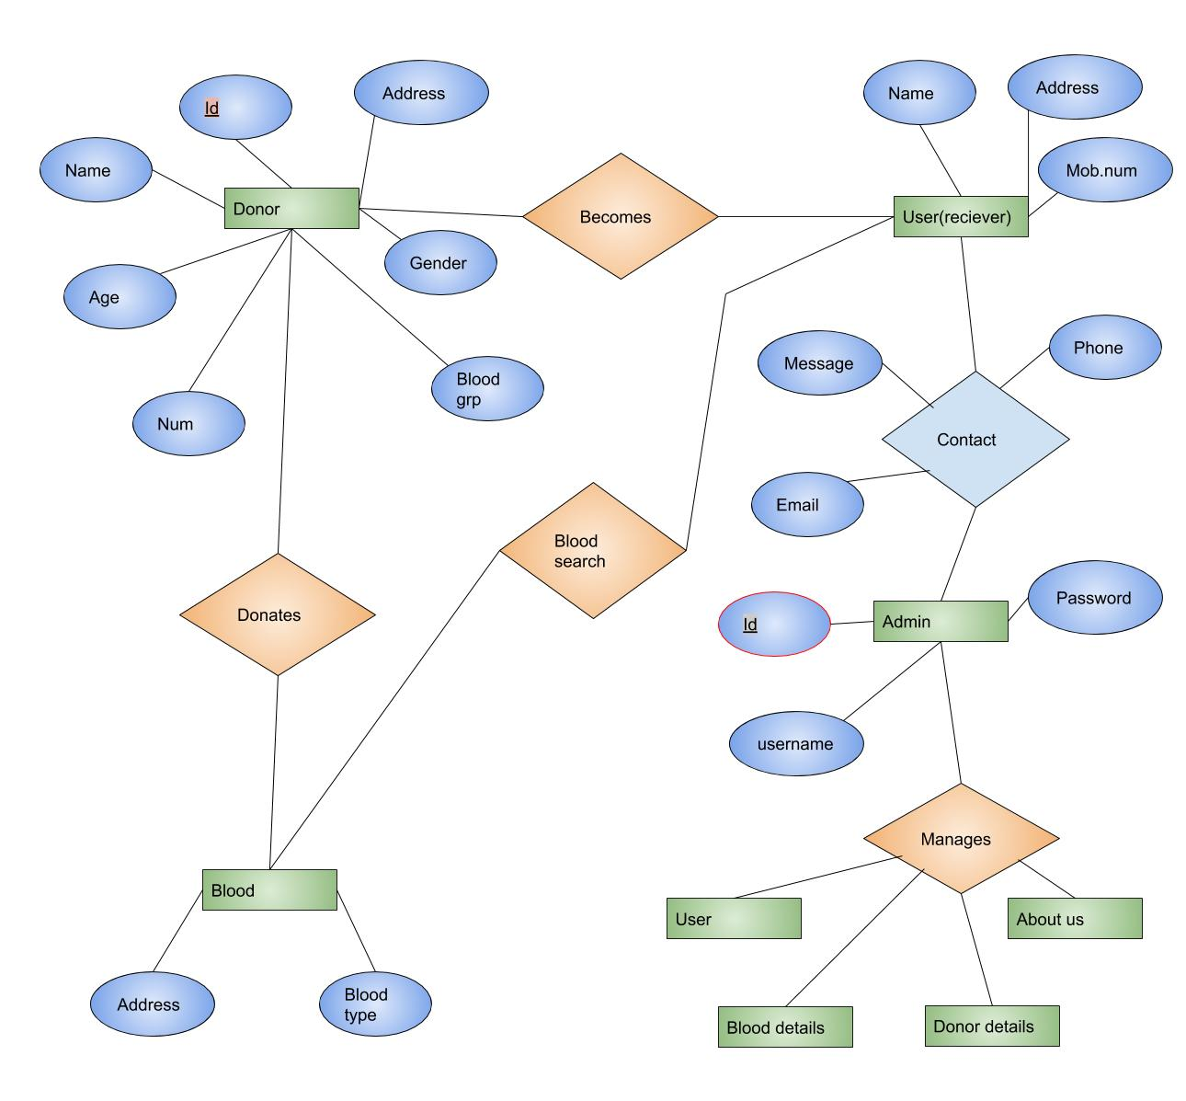
ENTITY-RELATIONSHIP DIAGRAM(module diagram)

Slide 10
MODULES
Admin login
Be a Donor
Stock details
Blood search
About us
Contact us

Slide 11
THANK YOU

